Slide 1
Privacy risk assessment for mobility data
The Web Conf 2019 - San Francisco. CA. USA

Slide 2
What’s the meaning of privacy?
Privacy has many connotations:
A series of principles Right to be let alone, to limit access to information etc.
Data privacy Regulated by national and international laws. Protect an individual's privacy and their personally identifiable information

Slide 3
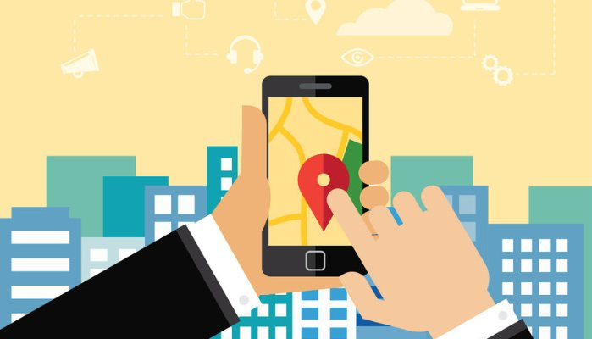
Why privacy for mobility data is a concern?
Mobility is a sensitive type of information Depending on the location visited, one could infer religious preferences, daily habits, health problems.
Mobility data is abundant and readily available Location based services, social media access etc.

Slide 4
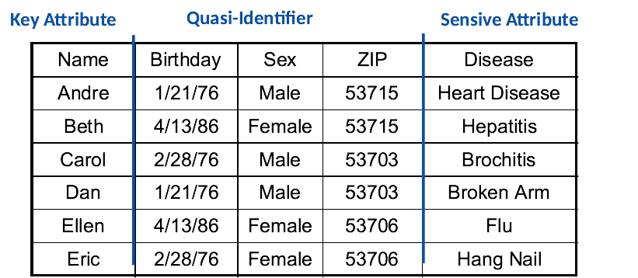
K-anonymity
Hide individuals amongst k-1 others
Generalization
Suppression
Privacy vs Utility Tradeoff
NP-Hard
Vulnerabilities: l-diversity and t-closeness

Slide 5
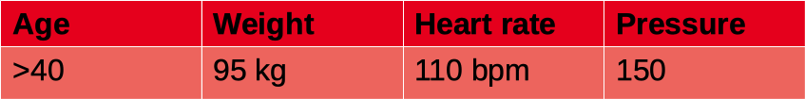
Structure of an attack
Individual record
Assumed adversary knowledge

Slide 6

For mobility data
Trajectory example
Day
Month
Worst case scenario approach
We assume that the adversary knows everything

Slide 7
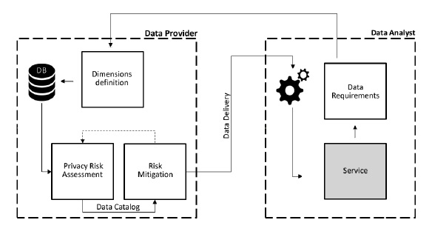
PRUDEnce privacy framework
Pellungrini et al., A Data Mining Approach to Assess Privacy Risk in Human Mobility Data, ACM TIST 2018
Pratesi et al., PRUDEnce: a System for Assessing Privacy Risk vs Utility in Data Sharing Ecosystems, Transactions on Data Privacy 2018.

Slide 8


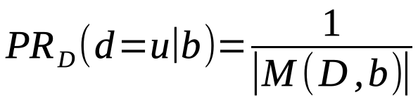
Risk definition
Background knowledge
Background knowledge instance
Probability of re-identification
Privacy risk

Slide 9
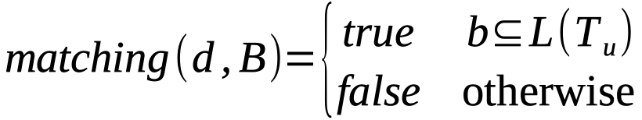
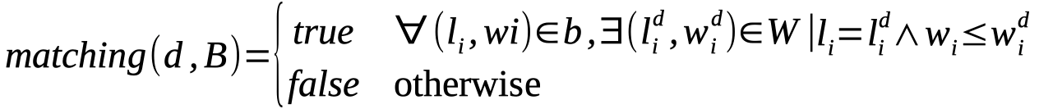
Matching
Location attack
Frequency attack

Slide 10
Defining attacks
Trajectories
Location
Sequence
Location + time
Derived structures: frequency and probability vectors
Unique locations
Frequency
Probability
Proportion
Home and work
Pellungrini et al., Analyzing Privacy Risk in Human Mobility Data, STAF Workshops 2018

Slide 11
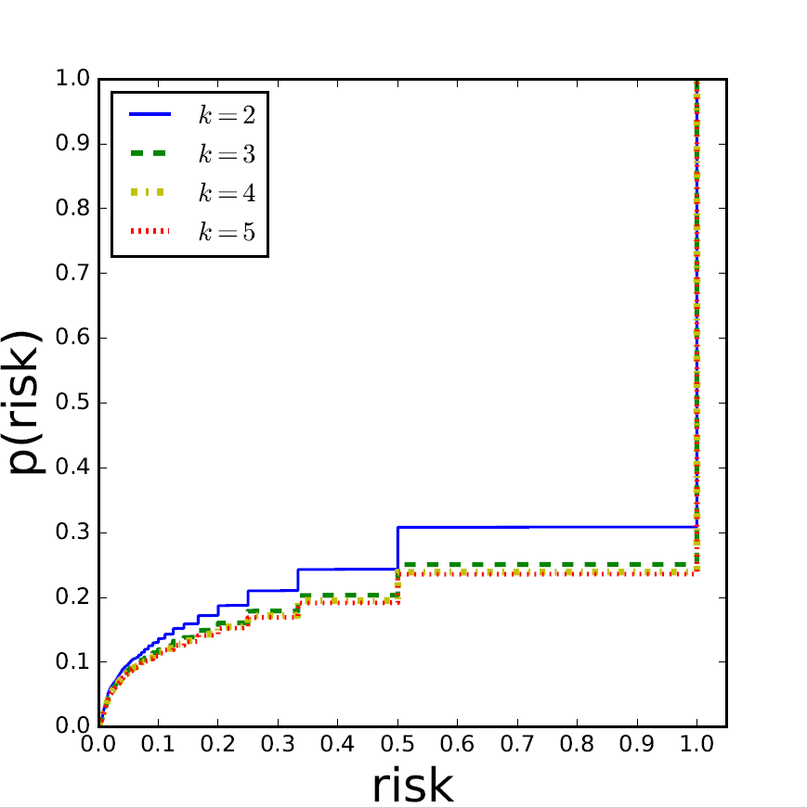
An example of real results
Location attack performed on real gps data from the city of Florence

Slide 12
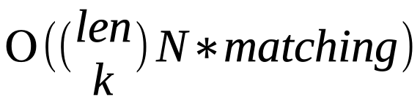
Computational complexity
For each individual compute all possible instances of background knowledge
For each instance, scan the data
Determine match between instance and individuals in the data
Complexity:

Slide 13
Further extensions
New attacks
Anonymization techniques
Dataset matching algorithms
Coming soon…

